Slide 1
Probabilistic Forecasting in Car Racing

Slide 2
Motivation
Useful for team, audience, and organizer
help to strategy optimization
monitoring and anomaly detection
attracting audiences and fans

Slide 3
Challenges
forecasting in car racing is challenging
Uncertainty in nature
crash
Highly dynamic
strategy dynamically adjusted during the race
High velocity of data stream
telemetry data stream evolves in tenth seconds

Slide 4
Problem
long term prediction is hard to be accurate due to the uncertainty nature
final rank prediction
short term prediction is more practical
Rank prediction
given history, predict the rank for a car serval laps in the future
accurate rank is available at the granularity of section and lap
Car status prediction
given history, predict the status for a car serval seconds in the future
car status is available through telemetry, e.g., vehicle speed, at the granularity of tenth second

Slide 5
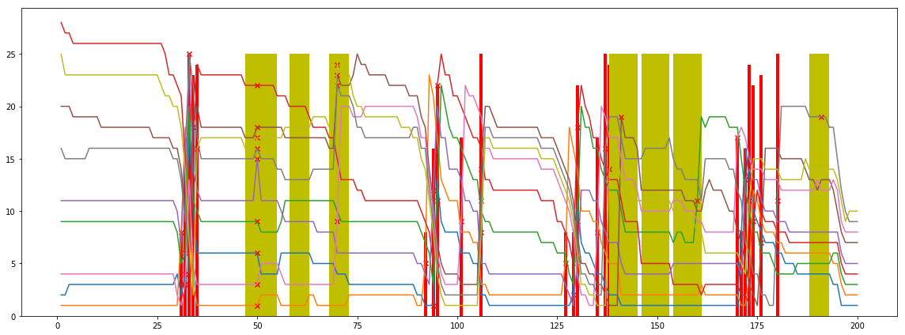
Rank is highly impacted by PitStop
Ranks evolving along with the laps. The Final top 10 cars in Indy500 2018. The red bar and the cross marker are pitstops. Yellow bars are caution laps.

Slide 6
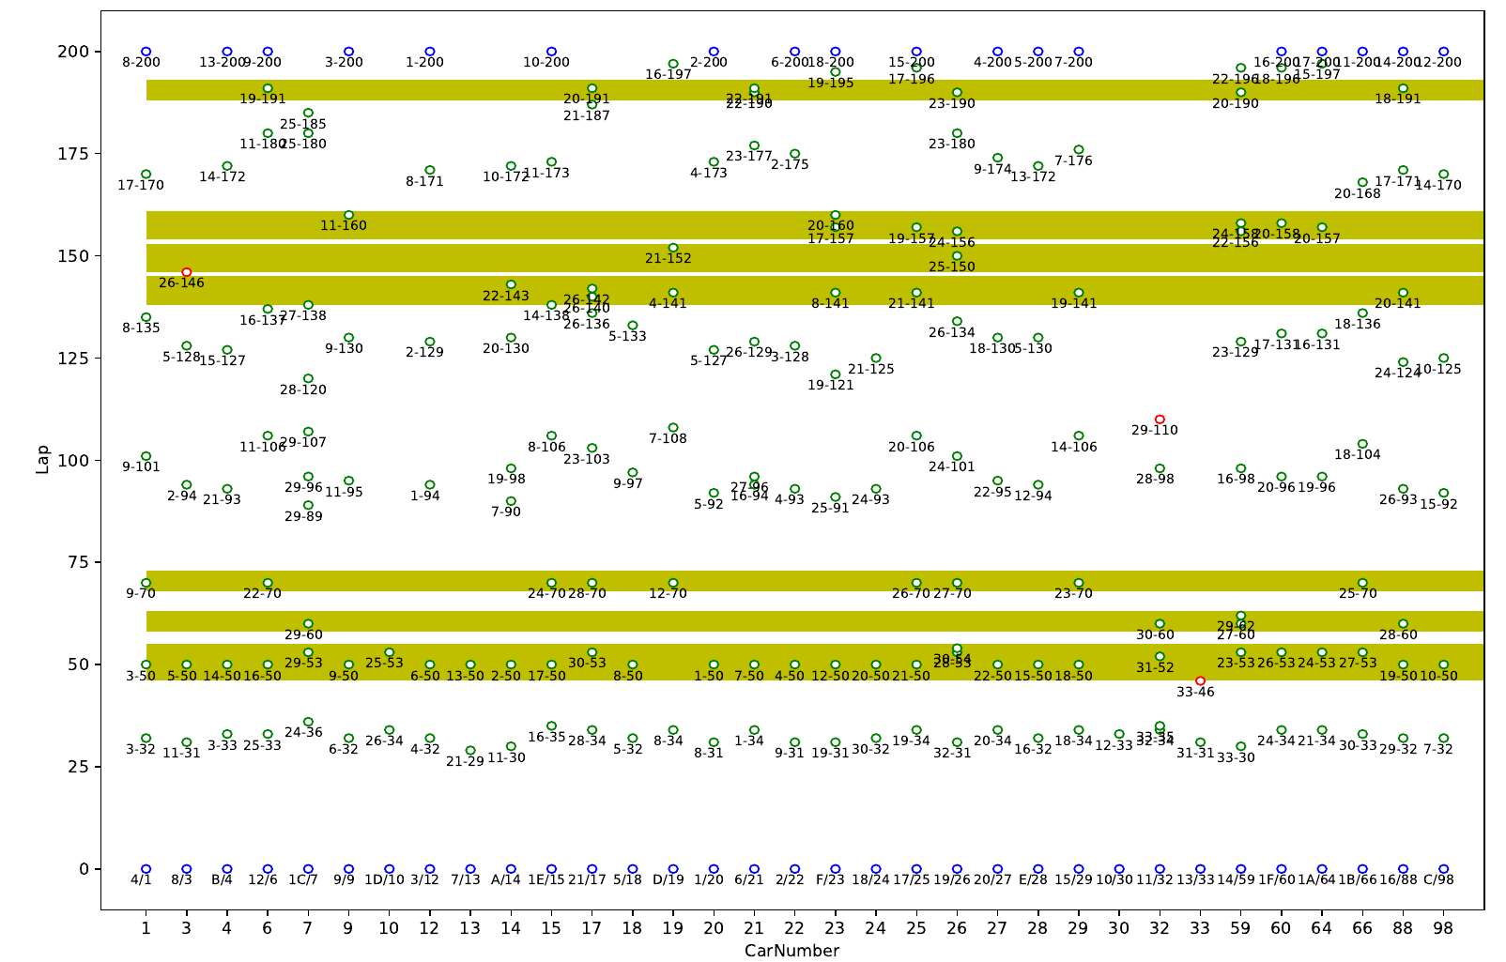
PitStops are not synchronized much in IndyCar
IndyCar (2018-Indy500, green circle denotes pitstop labeled with rank-lap, blue circles are the start/end position)

Slide 7
Rank Prediction
observation
Rank is highly impacted by PitStop
PitStops are not synchronized much in IndyCar
PitStops are dynamic according to strategy decisions
therefore
need probabilistic prediction instead of point wise prediction
Stint performance prediction could be a more stable task(weak)
rank changes in a stint(laps between two consecutive pitstops)

Slide 8
Rank Prediction
observation
rank as discrete events is more difficult
solution
rank can be deduced from Elapsedtime/Laptime
Elapsedtime/Laptime prediction is a real value regression task

Slide 9
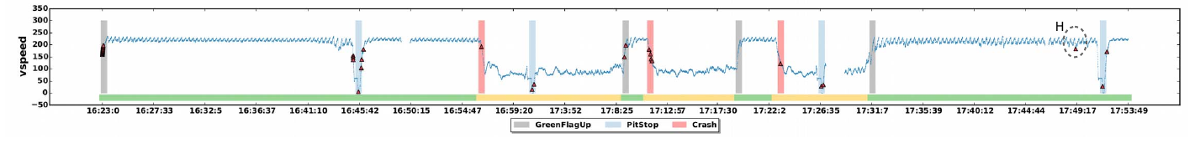
Car status prediction
impacted by PitStop and Crash
need probabilistic prediction instead of point wise prediction

Slide 10
Contributions
a probabilistic forecasting model based on encoder-decoder framework
joint train of target(laptime, vspeed) and uncertain event(pitstop)
performance comparison with state-of-the-art models

Slide 11
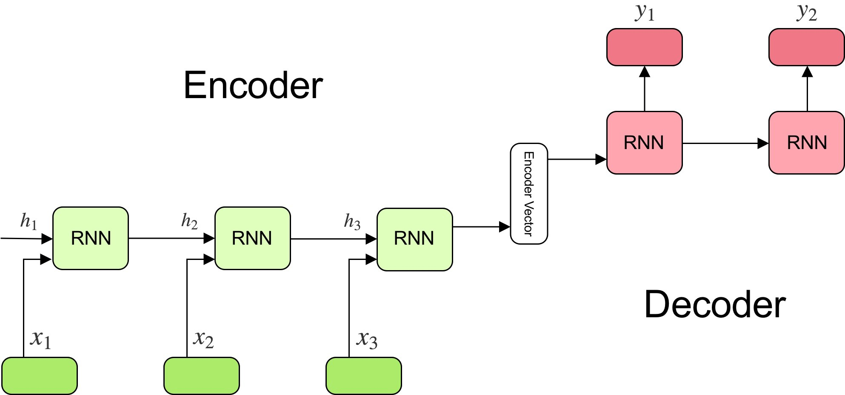
Encoder-Decoder
popular in time series forecasting

Slide 12
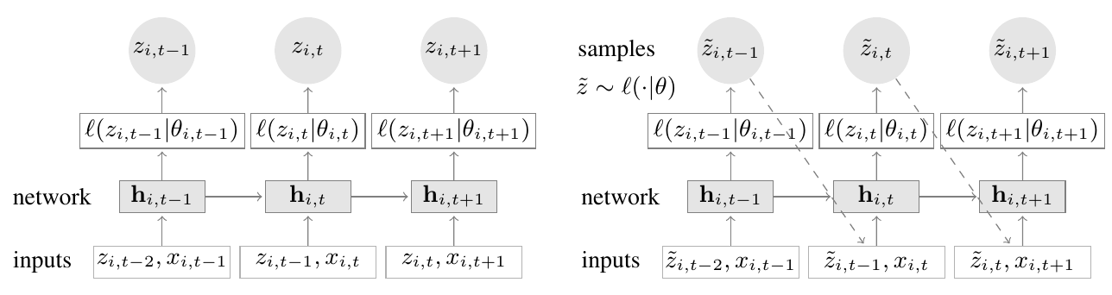
Probabilistic forecasting
Salinas, etc. 2019. “DeepAR: Probabilistic Forecasting with Autoregressive Recurrent Networks.” International Journal of Forecasting, October. 2019.07.001.
network to learn the parameters of a target distribution
distribution parameters depends on the context(through RNN)
network trainable by SGD

Slide 13
Joint train
Z_{t-1}
E_{t-1}
Z_{t}
E_{t}
Z_{t+1}
E_{t+1}
l(Z_{t-1}|θ_{t-1})
l’(E_{t-1}|θ’_{t-1})
l(Z_{t}|θ_{t})
l’(E_{t}|θ’_{t})
l(Z_{t+1}|θ_{t+1})
l’(E_{t+1}|θ’_{t+1})
h_{t-1}
h_{t}
h_{t+1}
Z_{t-2},E_{t-2},X_{t-1}
Z_{t-1},E_{t-1},X_{t}
Z_{t},E_{t},X_{t+1}
two different distribution joint training, Target(laptime, vspeed) and Uncertain Event(pitstop, crash)
different with DeepAR multivariate model, where Z has the same distribution

Slide 14
Preliminary results

Slide 15
Dataset
events = ['Phoenix','Indy500','Texas','Iowa','Pocono','Gateway']
Preprocessing
start prediction time as 80% of the longest time series
remove ts if it is too short
remove ts if missing data longer than 10%
Laptime (1 lap ts)
total 116 time series left as training data
VSpeed (1 second ts)
Pocono all removed (because of 2 hrs halt in the beginning of the race)
total 96 time series left as training data

Slide 16
Laptime baselines
laptime-gluonts-all-2018, non-interpolate, train 80%, prediction length=5 laps
Model | RMSE | NRMSE | P50-Risk | P90-Risk | Avg-Risk
Naive | 13.08 | 0.39 | 0.15 | 0.15 | 0.15
Arima | 12.21 | 0.37 | 0.19 | 0.15 | 0.14
ETS | 13.26 | 0.40 | 0.17 | 0.14 | 0.15
Prophet | 14.01 | 0.42 | 0.27 | 0.19 | 0.18
DeepAR | 11.69 | 0.35 | 0.15 | 0.14 | 0.11
Naive: predict by the last value
performance A .vs B, gain defined by (B-A)/B
DeepAR is better than the best of classical model Arima, DeepAR .vs. ARIMA
Model | RMSE | NRMSE | P50-Risk | P90-Risk | Avg-Risk
DeepAR | 0.04 | 0.05 | 0.21 | 0.07 | 0.21

Slide 17
Laptime
Model | RMSE | NRMSE | P50-Risk | P90-Risk | Avg-Risk
DeepAR | 11.69 | 0.35 | 0.15 | 0.14 | 0.11
DeepAR-Oracle | 5.75 | 0.17 | 0.064 | 0.039 | 0.045
DeepAR-Oracle-notrack | 10.75 | 0.32 | 0.14 | 0.12 | 0.1
DeepAR-Oracle-nolap | 6.42 | 0.19 | 0.074 | 0.057 | 0.056
DeepAR-CurTrack | 10.65 | 0.32 | 0.12 | 0.11 | 0.1
laptime-gluonts-all-2018, non-interpolate, train 80%, prediction length=5 laps
Model | RMSE | NRMSE | P50-Risk | P90-Risk | Avg-Risk
DeepAR-Oracle | 0.51 | 0.51 | 0.57 | 0.72 | 0.59
DeepAR-Oracle-notrack | 0.08 | 0.09 | 0.07 | 0.14 | 0.09
DeepAR-Oracle-nolap | 0.45 | 0.46 | 0.51 | 0.59 | 0.49
DeepAR-CurTrack | 0.09 | 0.09 | 0.20 | 0.21 | 0.09
DeepAR-Oracle: pitstop, yellowfalg as input in both training and prediction
DeepAR-Oracle-notrack: only pitstop used
DeepAR-Oracle-nolap: only yellow flag used
DeepAR-CurTrack: pitstop, yellowflag as input in training, but only use the last yellow flag status as input in prediction

Slide 18
Laptime
Model | RMSE | NRMSE | P50-Risk | P90-Risk | Avg-Risk
Arima | 12.77 | 0.38 | 0.21 | 0.18 | 0.16
DeepAR | 12.52 | 0.38 | 0.17 | 0.2 | 0.14
DeepAR-Oracle | 6.04 | 0.18 | 0.07 | 0.04 | 0.05
DeepAR-CurTrack | 13.67 | 0.41 | 0.18 | 0.18 | 0.16
laptime-gluonts-all-2018, non-interpolate, train 80%, prediction length=10 laps
Model | RMSE | NRMSE | P50-Risk | P90-Risk | Avg-Risk
DeepAR-Oracle | 0.52 | 0.53 | 0.59 | 0.80 | 0.64
deepAR-CurTrack | -0.09 | -0.08 | -0.06 | 0.10 | -0.14
DeepAR-CurTrack is not as good as it performs in lap5 prediction task
Joint training might give better results

Slide 19
vspeed baselines
telemetry-gluonts-all-2018, interpolate, train 80%, prediction length=200s
Model | RMSE | NRMSE | P50-Risk | P90-Risk | Avg-Risk
Arima | 43.83 | 0.28 | 0.17 | 0.1 | 0.13
ETS | 56.01 | 0.35 | 0.26 | 0.31 | 0.3
Prophet | 60.74 | 0.38 | 0.28 | 0.12 | 0.2
DeepAR | 42.48 | 0.27 | 0.19 | 0.11 | 0.14

Slide 20
VSpeed
Model | RMSE | NRMSE | P50-Risk | P90-Risk | Avg-Risk
DeepAR | 42.2 | 0.27 | 0.17 | 0.08 | 0.13
DeepAR-Oracle | 37.24 | 0.23 | 0.15 | 0.05 | 0.11
deepAR-CurTrack | 49.9 | 0.31 | 0.19 | 0.08 | 0.15
vspeed-gluonts-all-2018, non-interpolate, train 80%, prediction length=200 secs
Model | RMSE | NRMSE | P50-Risk | P90-Risk | Avg-Risk
DeepAR-Oracle | 0.12 | 0.15 | 0.12 | 0.38 | 0.15
deepAR-CurTrack | -0.18 | -0.15 | -0.12 | 0.00 | -0.15
Oracle get 12%-15% performance gain.
CurTrack goes worse.
todo
currently, Pitstop set for a whole lap -> fix by set in only section 1

Slide 21
Conclusion
The gap between DeepAR-Oracle and DeepAR shows the space to improve.
Joint model might be promising to decrease this gap.

Slide 22
todo
Implement the joint training model
test with other available input features
compare with point-wise machine learning models

Slide 23
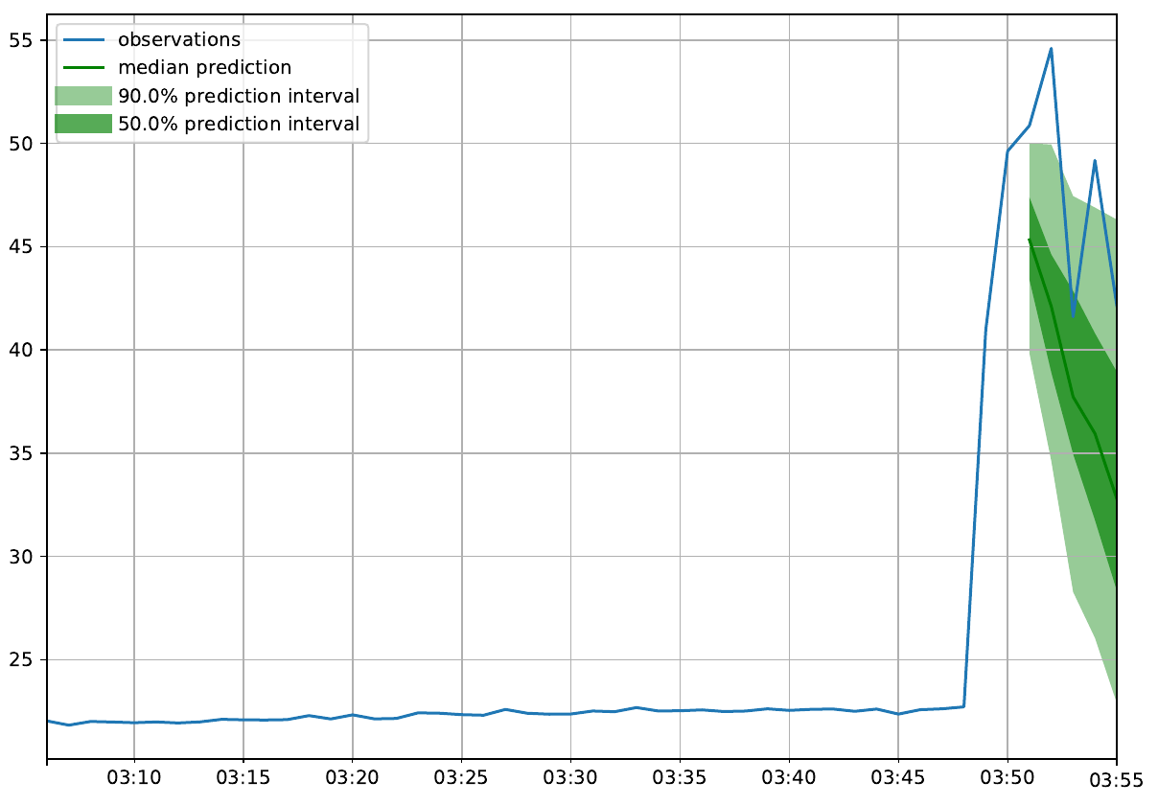
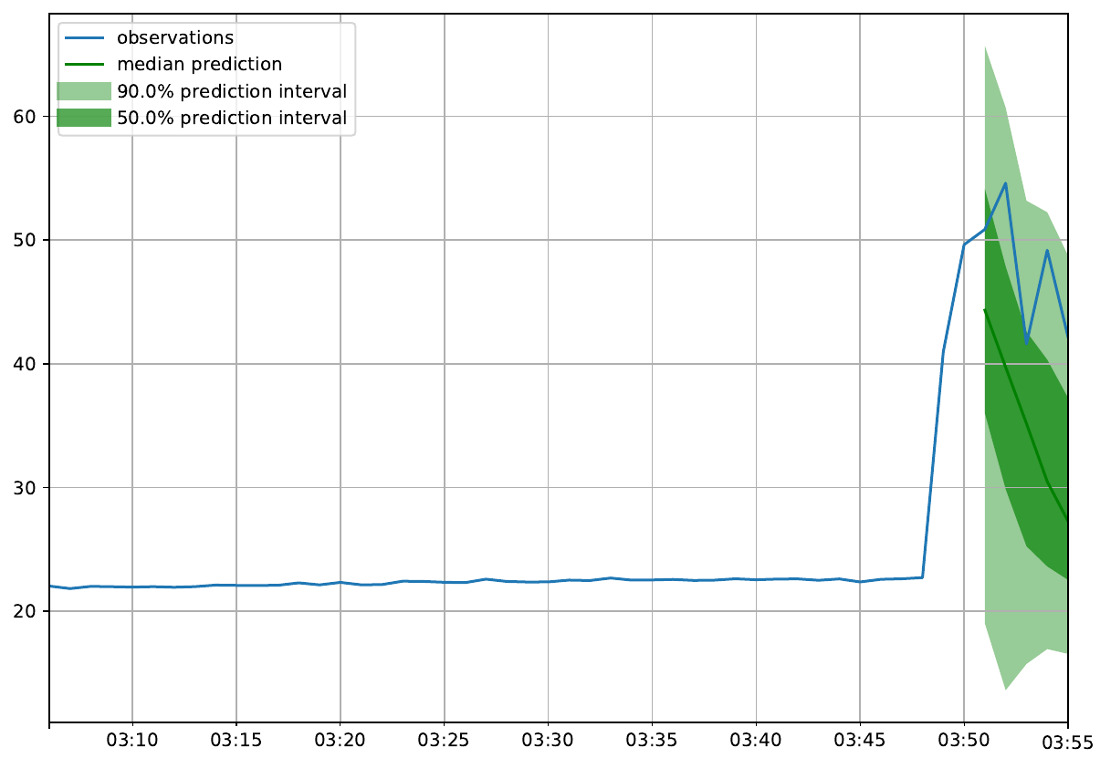
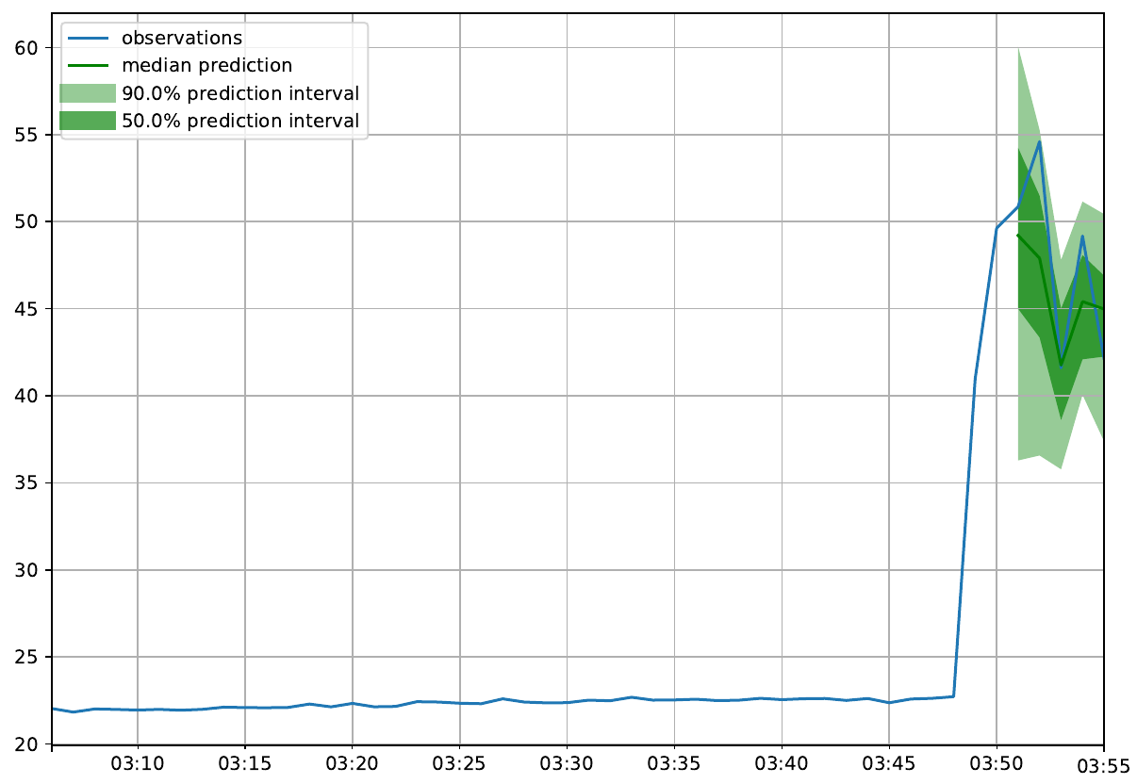
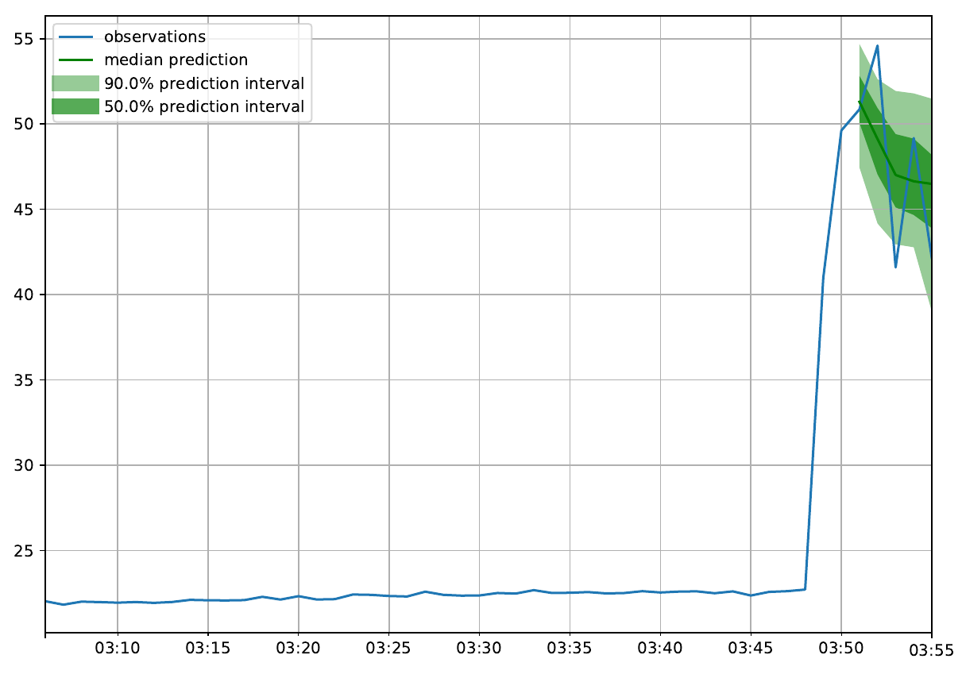
laptime
ARIMA
DeepAR
DeepAR-Oracle
DeepAR-CurTrack

Slide 24
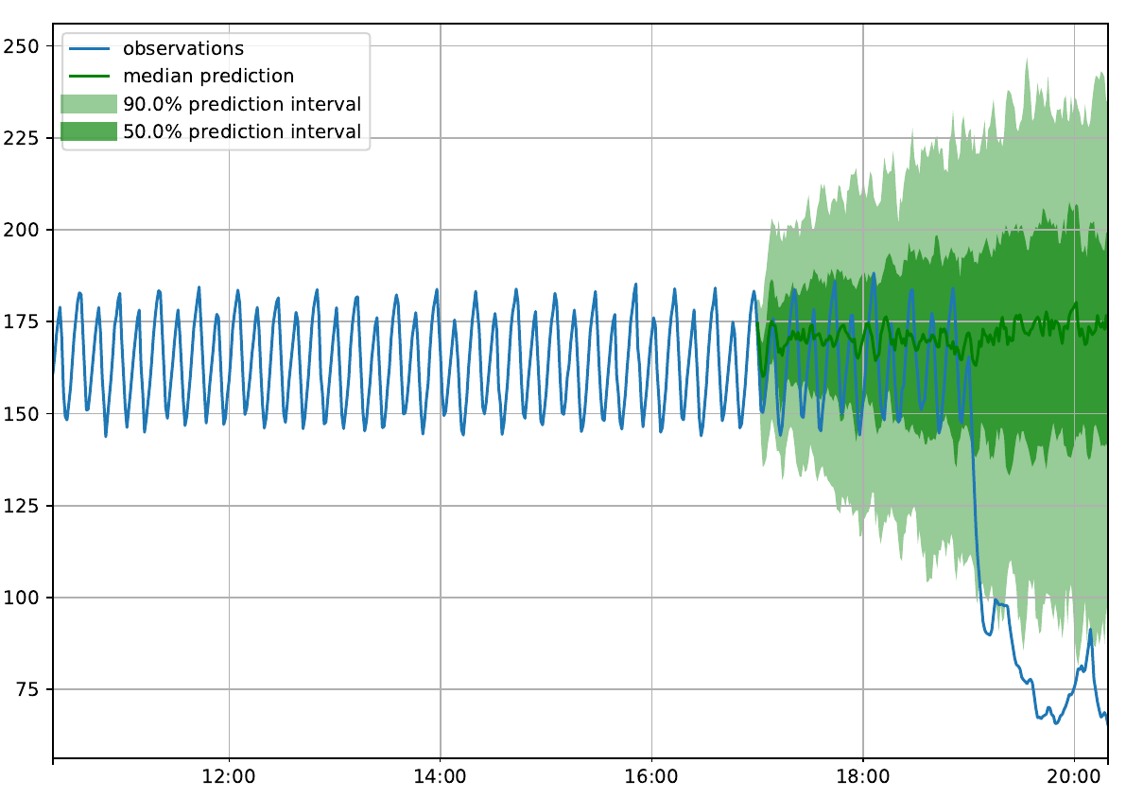
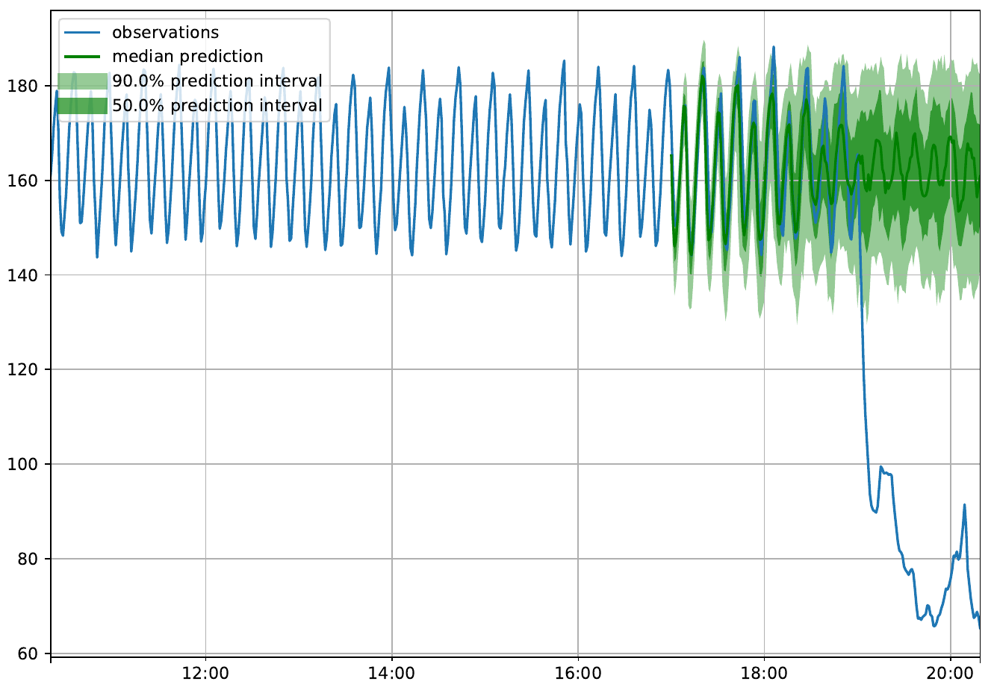
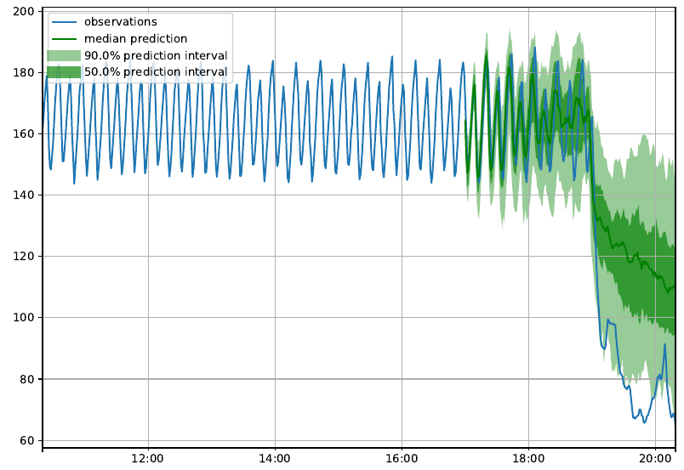
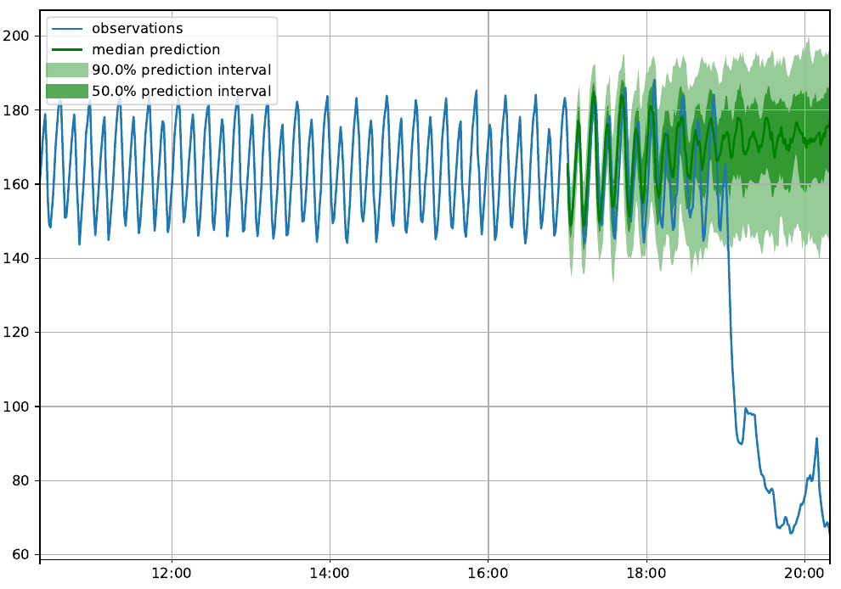
vspeed
ARIMA
DeepAR
DeepAR-Oracle
DeepAR-CurTrack

